Slide 1
Lecture 3
Asymptotic Notations – Insertion Sort

Slide 2
o-notation
The asymptotic upper bound provided by big O-notation may or may not be asymptotically tight. The bound 2n²=O(n²) is asymptotically tight, but the bound 2n=O(n²) is not.
We use o-notation to denote an upper bound that is not asymptotically tight.
We formally define o(g(n)) as the set
o(g(n))={f(n) : for any positive constant c>0, there exists a constant n₀>0 such that 0≤f(n)<cg(n) for all n ≥ n₀}
For example, 2n=o(n²), but 2n² ≠ o(n²).
February 12, 2020
Instructor:- Mr. Fazl-e-Basit

Slide 3
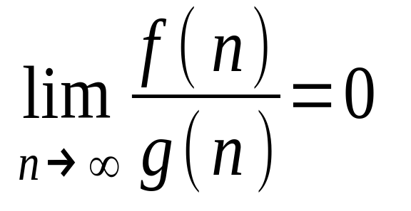
The definition of O-notation and o-notation are similar. The main difference is that in f(n)=O(g(n)), the bound 0 ≤ f(n) ≤ cg(n) holds for some constant c>0, but in f(n)=o(g(n)), the bound 0 ≤ f(n) < cg(n) holds for all constants c>0.
Intuitively, in the o-notation, the function f(n) becomes insignificant relative to g(n) as n approaches infinity; that is,
February 12, 2020
Instructor:- Mr. Fazl-e-Basit

Slide 4
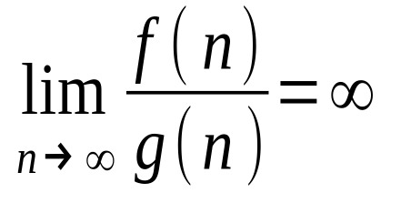
ω-notation
We use ω-notation to denote a lower bound that is not asymptotically tight. One way to define it is by
f(n)∈ω(g(n)) if and only if g(n)∈o(f(n)).
Formally, however we define ω (g(n)) as the set ω(g(n))={f(n): for any positive constant c>0, there exists a constant n₀>0 such that 0 ≤cg(n)<f(n) for all n ≥ n₀}
For example, n²/2=ω(n), but n²/2≠ω(n²). The relation f(n)= ω(g(n)) implies that
if the limit exists that is, f(n) becomes arbitrarily large relative to g(n) as n approaches infinity.
February 12, 2020
Instructor:- Mr. Fazl-e-Basit

Slide 5
Some readers may find it strange that we should write, for example, n = O(n²).
In literature, O – notation is sometimes used informally to describe asymptotic tight bound, i.e. what we have done using Θ–notation.
However, in this course, when we write
f(n) = O( g(n) ) , we are merely (purely) claiming that some constant multiple of g(n) is an asymptotic upper bound on f(n), with no claim about how tight an upper bound it is.
February 12, 2020
Instructor:- Mr. Fazl-e-Basit

Slide 6
Worst case
  Provides an upper bound on running time
  An absolute guarantee
Average case
  Provides the expected running time
  Very useful, but treat with care: what is “average”?
    Random (equally likely) inputs
    Real-life inputs
Best case
  Provides lower bound on running time
February 12, 2020
Instructor:- Mr. Fazl-e-Basit

Slide 7
Input Size
In general, time taken by an algorithm grows with the size of the input, so it is traditional to describe the running time of the program as a function of size of its input.
How we characterize input (for e.g.):
  Sorting: number of input items
  Multiplication: total number of bits
  If the input to the algorithm is Graph, the input size can be described by the : number of nodes & edges
  Etc
February 12, 2020
Instructor:- Mr. Fazl-e-Basit

Slide 8
Running Time
The running time of an algorithm on a particular input is the number of primitive steps or operations executed.
For the next coming lectures we will assume a constant amount of time is required to execute each line of our pseudo code.
One line may take different amount of time than another line, but we shall assume that each execution of the i^{th} line takes time c_{i}, where c_{i} is the constant.
February 12, 2020
Instructor:- Mr. Fazl-e-Basit

Slide 9
Example: Insertion Sort (pseudo code)
Insertion_Sort(A, n)
{
for j = 2 to n
{
key = A[j]
i = j - 1;
while (i > 0) and (A[i] > key)
{
A[i+1] = A[i]
i = i - 1
}
A[i+1] = key
}
}
30
10
40
20
1
2
3
4
February 12, 2020
Instructor:- Mr. Fazl-e-Basit

Slide 10

An Example: insertion Sort
30
10
40
20
j = ∅ i = ∅ key = ∅
A[i] = ∅ A[i+1] = ∅
1
2
3
4
jnsertjonSort(A, n) {
for j = 2 to n {
key = A[j]
i = j - 1;
whjle (i > 0) and (A[i] > key) {
A[i+1] = A[i]
i = i - 1
}
A[i+1] = key
}
}
February 12, 2020
Instructor:- Mr. Fazl-e-Basit

Slide 11

An Example: insertion Sort
30
10
40
20
j = 2 i = 1 key = 10
A[i] = 30 A[i+1] = 10
1
2
3
4
jnsertjonSort(A, n) {
for j = 2 to n {
key = A[j]
i = j - 1;
while (i > 0) and (A[i] > key) {
A[i+1] = A[i]
i = i - 1
}
A[i+1] = key
}
}
February 12, 2020
Instructor:- Mr. Fazl-e-Basit

Slide 12

An Example: insertion Sort
30
30
40
20
j = 2 i = 1 key = 10
A[i] = 30 A[i+1] = 30
1
2
3
4
jnsertjonSort(A, n) {
for j = 2 to n {
key = A[j]
i = j - 1;
while (i > 0) and (A[i] > key) {
A[i+1] = A[i]
i = i - 1
}
A[i+1] = key
}
}
February 12, 2020
Instructor:- Mr. Fazl-e-Basit

Slide 13

An Example: insertion Sort
30
30
40
20
j = 2 i = 1 key = 10
A[i] = 30 A[i+1] = 30
1
2
3
4
jnsertjonSort(A, n) {
for j = 2 to n {
key = A[j]
i = j - 1;
while (i > 0) and (A[i] > key) {
A[i+1] = A[i]
i = i - 1
}
A[i+1] = key
}
}
February 12, 2020
Instructor:- Mr. Fazl-e-Basit

Slide 14

An Example: insertion Sort
30
30
40
20
j = 2 i = 0 key = 10
A[i] = ∅ A[i+1] = 30
1
2
3
4
jnsertjonSort(A, n) {
for j = 2 to n {
key = A[j]
i = j - 1;
while (i > 0) and (A[i] > key) {
A[i+1] = A[i]
i = i - 1
}
A[i+1] = key
}
}
February 12, 2020
Instructor:- Mr. Fazl-e-Basit

Slide 15

An Example: insertion Sort
30
30
40
20
j = 2 i = 0 key = 10
A[i] = ∅ A[i+1] = 30
1
2
3
4
jnsertjonSort(A, n) {
for j = 2 to n {
key = A[j]
i = j - 1;
while (i > 0) and (A[i] > key) {
A[i+1] = A[i]
i = i - 1
}
A[i+1] = key
}
}
February 12, 2020
Instructor:- Mr. Fazl-e-Basit

Slide 16

An Example: insertion Sort
10
30
40
20
j = 2 i = 0 key = 10
A[i] = ∅ A[i+1] = 10
1
2
3
4
jnsertjonSort(A, n) {
for j = 2 to n {
key = A[j]
i = j - 1;
while (i > 0) and (A[i] > key) {
A[i+1] = A[i]
i = i - 1
}
A[i+1] = key
}
}
February 12, 2020
Instructor:- Mr. Fazl-e-Basit

Slide 17

An Example: insertion Sort
10
30
40
20
j = 3 i = 0 key = 10
A[i] = ∅ A[i+1] = 10
1
2
3
4
jnsertjonSort(A, n) {
for j = 2 to n {
key = A[j]
i = j - 1;
while (i > 0) and (A[i] > key) {
A[i+1] = A[i]
i = i - 1
}
A[i+1] = key
}
}
February 12, 2020
Instructor:- Mr. Fazl-e-Basit

Slide 18

An Example: insertion Sort
10
30
40
20
j = 3 i = 0 key = 40
A[i] = ∅ A[i+1] = 10
1
2
3
4
jnsertjonSort(A, n) {
for j = 2 to n {
key = A[j]
i = j - 1;
while (i > 0) and (A[i] > key) {
A[i+1] = A[i]
i = i - 1
}
A[i+1] = key
}
}
February 12, 2020
Instructor:- Mr. Fazl-e-Basit

Slide 19

An Example: insertion Sort
10
30
40
20
j = 3 i = 0 key = 40
A[i] = ∅ A[i+1] = 10
1
2
3
4
jnsertjonSort(A, n) {
for j = 2 to n {
key = A[j]
i = j - 1;
while (i > 0) and (A[i] > key) {
A[i+1] = A[i]
i = i - 1
}
A[i+1] = key
}
}
February 12, 2020
Instructor:- Mr. Fazl-e-Basit

Slide 20

An Example: insertion Sort
10
30
40
20
j = 3 i = 2 key = 40
A[i] = 30 A[i+1] = 40
1
2
3
4
jnsertjonSort(A, n) {
for j = 2 to n {
key = A[j]
i = j - 1;
while (i > 0) and (A[i] > key) {
A[i+1] = A[i]
i = i - 1
}
A[i+1] = key
}
}
February 12, 2020
Instructor:- Mr. Fazl-e-Basit

Slide 21

An Example: insertion Sort
10
30
40
20
j = 3 i = 2 key = 40
A[i] = 30 A[i+1] = 40
1
2
3
4
jnsertjonSort(A, n) {
for j = 2 to n {
key = A[j]
i = j - 1;
while (i > 0) and (A[i] > key) {
A[i+1] = A[i]
i = i - 1
}
A[i+1] = key
}
}
February 12, 2020
Instructor:- Mr. Fazl-e-Basit

Slide 22

An Example: insertion Sort
10
30
40
20
j = 3 i = 2 key = 40
A[i] = 30 A[i+1] = 40
1
2
3
4
jnsertjonSort(A, n) {
for j = 2 to n {
key = A[j]
i = j - 1;
while (i > 0) and (A[i] > key) {
A[i+1] = A[i]
i = i - 1
}
A[i+1] = key
}
}
February 12, 2020
Instructor:- Mr. Fazl-e-Basit

Slide 23

An Example: insertion Sort
10
30
40
20
j = 4 i = 2 key = 40
A[i] = 30 A[i+1] = 40
1
2
3
4
jnsertjonSort(A, n) {
for j = 2 to n {
key = A[j]
i = j - 1;
while (i > 0) and (A[i] > key) {
A[i+1] = A[i]
i = i - 1
}
A[i+1] = key
}
}
February 12, 2020
Instructor:- Mr. Fazl-e-Basit

Slide 24

An Example: insertion Sort
10
30
40
20
j = 4 i = 2 key = 20
A[i] = 30 A[i+1] = 40
1
2
3
4
jnsertjonSort(A, n) {
for j = 2 to n {
key = A[j]
i = j - 1;
while (i > 0) and (A[i] > key) {
A[i+1] = A[i]
i = i - 1
}
A[i+1] = key
}
}
February 12, 2020
Instructor:- Mr. Fazl-e-Basit

Slide 25

An Example: insertion Sort
10
30
40
20
j = 4 i = 2 key = 20
A[i] = 30 A[i+1] = 40
1
2
3
4
jnsertjonSort(A, n) {
for j = 2 to n {
key = A[j]
i = j - 1;
while (i > 0) and (A[i] > key) {
A[i+1] = A[i]
i = i - 1
}
A[i+1] = key
}
}
February 12, 2020
Instructor:- Mr. Fazl-e-Basit

Slide 26

An Example: insertion Sort
10
30
40
20
j = 4 i = 3 key = 20
A[i] = 40 A[i+1] = 20
1
2
3
4
jnsertjonSort(A, n) {
for j = 2 to n {
key = A[j]
i = j - 1;
whjle (i > 0) and (A[i] > key) {
A[i+1] = A[i]
i = i - 1
}
A[i+1] = key
}
}
February 12, 2020
Instructor:- Mr. Fazl-e-Basit

Slide 27

An Example: insertion Sort
10
30
40
20
j = 4 i = 3 key = 20
A[i] = 40 A[i+1] = 20
1
2
3
4
jnsertjonSort(A, n) {
for j = 2 to n {
key = A[j]
i = j - 1;
whjle (i > 0) and (A[i] > key) {
A[i+1] = A[i]
i = i - 1
}
A[i+1] = key
}
}
February 12, 2020
Instructor:- Mr. Fazl-e-Basit

Slide 28

An Example: insertion Sort
10
30
40
40
j = 4 i = 3 key = 20
A[i] = 40 A[i+1] = 40
1
2
3
4
jnsertjonSort(A, n) {
for j = 2 to n {
key = A[j]
i = j - 1;
whjle (i > 0) and (A[i] > key) {
A[i+1] = A[i]
i = i - 1
}
A[i+1] = key
}
}
February 12, 2020
Instructor:- Mr. Fazl-e-Basit

Slide 29

An Example: insertion Sort
10
30
40
40
j = 4 i = 3 key = 20
A[i] = 40 A[i+1] = 40
1
2
3
4
jnsertjonSort(A, n) {
for j = 2 to n {
key = A[j]
i = j - 1;
whjle (i > 0) and (A[i] > key) {
A[i+1] = A[i]
i = i - 1
}
A[i+1] = key
}
}
February 12, 2020
Instructor:- Mr. Fazl-e-Basit

Slide 30

An Example: insertion Sort
10
30
40
40
j = 4 i = 3 key = 20
A[i] = 40 A[i+1] = 40
1
2
3
4
jnsertjonSort(A, n) {
for j = 2 to n {
key = A[j]
i = j - 1;
whjle (i > 0) and (A[i] > key) {
A[i+1] = A[i]
i = i - 1
}
A[i+1] = key
}
}
February 12, 2020
Instructor:- Mr. Fazl-e-Basit

Slide 31

An Example: insertion Sort
10
30
40
40
j = 4 i = 2 key = 20
A[i] = 30 A[i+1] = 40
1
2
3
4
jnsertjonSort(A, n) {
for j = 2 to n {
key = A[j]
i = j - 1;
whjle (i > 0) and (A[i] > key) {
A[i+1] = A[i]
i = i - 1
}
A[i+1] = key
}
}
February 12, 2020
Instructor:- Mr. Fazl-e-Basit

Slide 32

An Example: insertion Sort
10
30
40
40
j = 4 i = 2 key = 20
A[i] = 30 A[i+1] = 40
1
2
3
4
jnsertjonSort(A, n) {
for j = 2 to n {
key = A[j]
i = j - 1;
whjle (i > 0) and (A[i] > key) {
A[i+1] = A[i]
i = i - 1
}
A[i+1] = key
}
}
February 12, 2020
Instructor:- Mr. Fazl-e-Basit

Slide 33
An Example: insertion Sort
10
30
30
40
j = 4 i = 2 key = 20
A[i] = 30 A[i+1] = 30
1
2
3
4
jnsertjonSort(A, n) {
for j = 2 to n {
key = A[j]
i = j - 1;
whjle (i > 0) and (A[i] > key) {
A[i+1] = A[i]
i = i - 1
}
A[i+1] = key
}
}
February 12, 2020
Instructor:- Mr. Fazl-e-Basit

Slide 34

An Example: insertion Sort
10
30
30
40
j = 4 i = 2 key = 20
A[i] = 30 A[i+1] = 30
1
2
3
4
jnsertjonSort(A, n) {
for j = 2 to n {
key = A[j]
i = j - 1;
whjle (i > 0) and (A[i] > key) {
A[i+1] = A[i]
i = i - 1
}
A[i+1] = key
}
}
February 12, 2020
Instructor:- Mr. Fazl-e-Basit

Slide 35

An Example: insertion Sort
10
30
30
40
j = 4 i = 1 key = 20
A[i] = 10 A[i+1] = 30
1
2
3
4
jnsertjonSort(A, n) {
for j = 2 to n {
key = A[j]
i = j - 1;
whjle (i > 0) and (A[i] > key) {
A[i+1] = A[i]
i = i - 1
}
A[i+1] = key
}
}
February 12, 2020
Instructor:- Mr. Fazl-e-Basit

Slide 36

An Example: insertion Sort
10
30
30
40
j = 4 i = 1 key = 20
A[i] = 10 A[i+1] = 30
1
2
3
4
jnsertjonSort(A, n) {
for j = 2 to n {
key = A[j]
i = j - 1;
whjle (i > 0) and (A[i] > key) {
A[i+1] = A[i]
i = i - 1
}
A[i+1] = key
}
}
February 12, 2020
Instructor:- Mr. Fazl-e-Basit

Slide 37

An Example: insertion Sort
10
20
30
40
j = 4 i = 1 key = 20
A[i] = 10 A[i+1] = 20
1
2
3
4
jnsertjonSort(A, n) {
for j = 2 to n {
key = A[j]
i = j - 1;
whjle (i > 0) and (A[i] > key) {
A[i+1] = A[i]
i = i - 1
}
A[i+1] = key
}
}
February 12, 2020
Instructor:- Mr. Fazl-e-Basit

Slide 38
An Example: insertion Sort
10
20
30
40
j = 4 i = 1 key = 20
A[i] = 10 A[i+1] = 20
1
2
3
4
jnsertjonSort(A, n) {
for j = 2 to n {
key = A[j]
i = j - 1;
whjle (i > 0) and (A[i] > key) {
A[i+1] = A[i]
i = i - 1
}
A[i+1] = key
}
}
Done!
February 12, 2020
Instructor:- Mr. Fazl-e-Basit

Slide 39
We start by presenting the insertion sort with the time “cost” of each statement and the number of times each statement is executed.
For each value of j = 2,3,4…… n, where n = length of array (input), we say t_{j} be the number of times the while loop test in above program is executed for that value of j.
February 12, 2020
Instructor:- Mr. Fazl-e-Basit

Slide 40
Insertion Sort
Statement cost times
InsertionSort(A, n) {
for j = 2 to n { c₁ n
key = A[j] c₂ (n-1)
i = j - 1; c₄ (n-1)
while (i > 0) and (A[i] > key){ c₅ A
A[i+1] = A[i] c₆ B
i = i - 1 c₇ C
} 0
A[i+1] = key c₈ (n-1)
} 0
}
February 12, 2020
Instructor:- Mr. Fazl-e-Basit

Slide 41
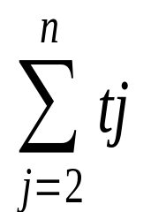
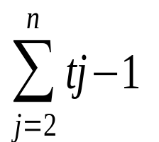
Where
A =
B =
C =
tj means t_{j}
February 12, 2020
Instructor:- Mr. Fazl-e-Basit

Slide 42
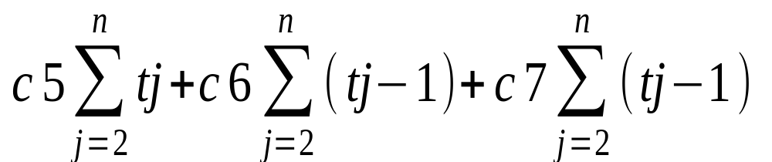
So The running time of the algorithm is the sum of each statement executed. To compute T(n), the total running time of INSERTION SORT, we sum the products of the cost and times columns, obtaining
T(n) = c1n + c2(n-1) + c4(n-1) +
+ c8(n-1)
February 12, 2020
Instructor:- Mr. Fazl-e-Basit

Slide 43
The best case occurs if array is already sorted. Thus tj = 1 for all j = 2,3,4….n, and the best case running time would be
T(n) = c1n + c2(n-1) + c4(n-1) + c5(n-1) + c8(n-1)
= (c1+c2+c4+c5+c8)n - (c2+c4+c5+c8)
This running time can be expressed as an + b for constants a & b; depends on the statement costs: thus it is a linear function of n.
February 12, 2020
Instructor:- Mr. Fazl-e-Basit

Slide 44
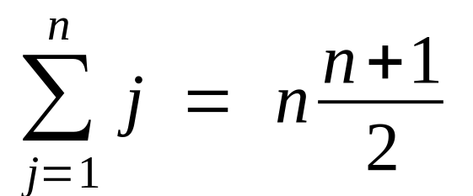
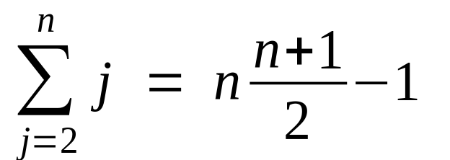
If array is in reverse sorted order, then worst case running time would be resulting.
We have the mathematical formula:
So we will have
February 12, 2020
Instructor:- Mr. Fazl-e-Basit

Slide 45
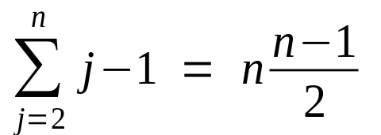
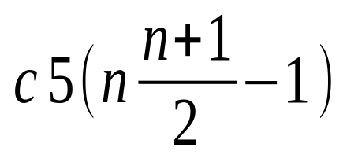
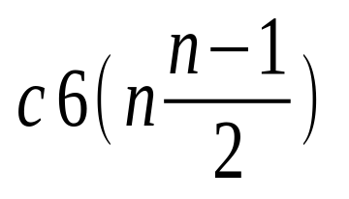
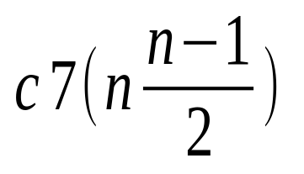
Similarly we have
We find that worst case running time of Insertion sort is:
T(n) = c1n + c2(n-1) + c4(n-1) + +
+ + c8(n-1)
The worst case running time can be expressed as an² + bn + c; thus a quadratic function of n.
February 12, 2020
Instructor:- Mr. Fazl-e-Basit

Slide 46
We say Insertion Sort’s run time is O(n²)
  Properly we should say run time is in O(n²)
Questions
  Is InsertionSort O(n) ?
  Big-O Is wrost cast which we find the n^2 so O(n) is not possible.
  Is InsertionSort O(n³) ?
  Same as above wrost case is n^2 this is not possible
  Is InsertionSort Ω (n) ?
  Yes this is possible in best case when array is already sorted …..
February 12, 2020
Instructor:- Mr. Fazl-e-Basit

Slide 47
We have studied insertion sort. The best case running time of this algorithm is Ω(n) which implies that the running time of insertion sort is Ω(n).
So it means running time of insertion sort falls between Ω(n) and O(n²).
It does not means that running time of insertion sort is Ω(n²).
It is not contradictory, however to say that worst case running time of insertion sort is Ω(n²), since there is an input which causes the algorithm to take Ω(n²) time.
February 12, 2020
Instructor:- Mr. Fazl-e-Basit

Slide 48
When we say that the running time ( no modifier ) of an algorithm is Ω( g(n) ), we mean that no matter what particular input of size n is chosen , the running time on that input is at least constant times g(n) for sufficiently large n.
February 12, 2020
Instructor:- Mr. Fazl-e-Basit

Slide 49
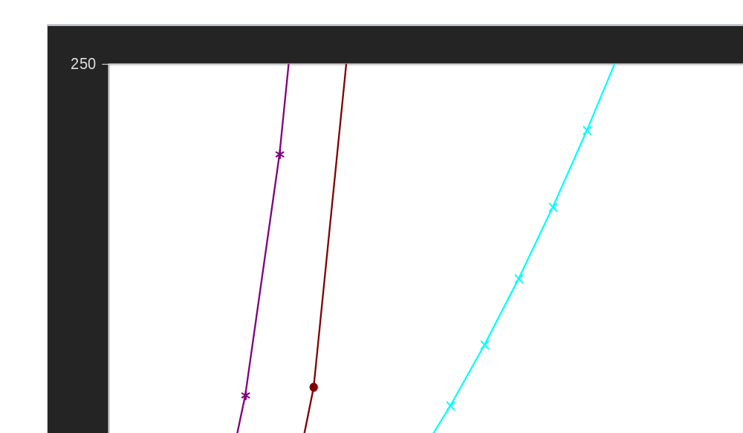
Practical Complexity
February 12, 2020
Instructor:- Mr. Fazl-e-Basit

Slide 50
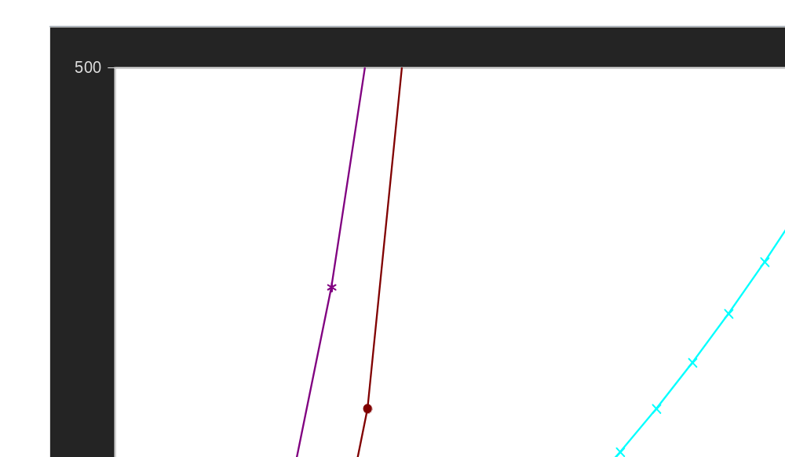
Practical Complexity
February 12, 2020
Instructor:- Mr. Fazl-e-Basit

Slide 51
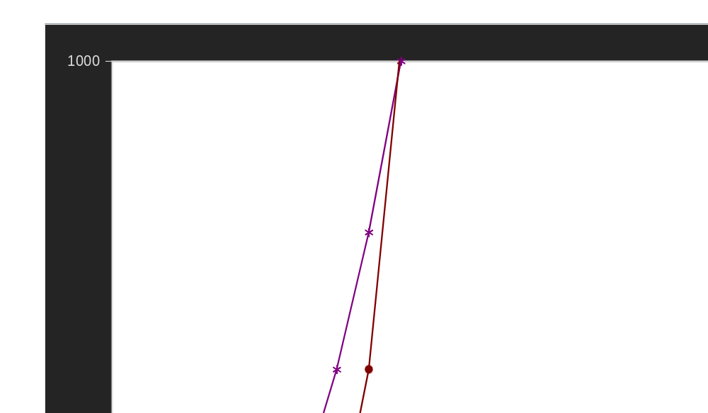
Practical Complexity
February 12, 2020
Instructor:- Mr. Fazl-e-Basit

Slide 52
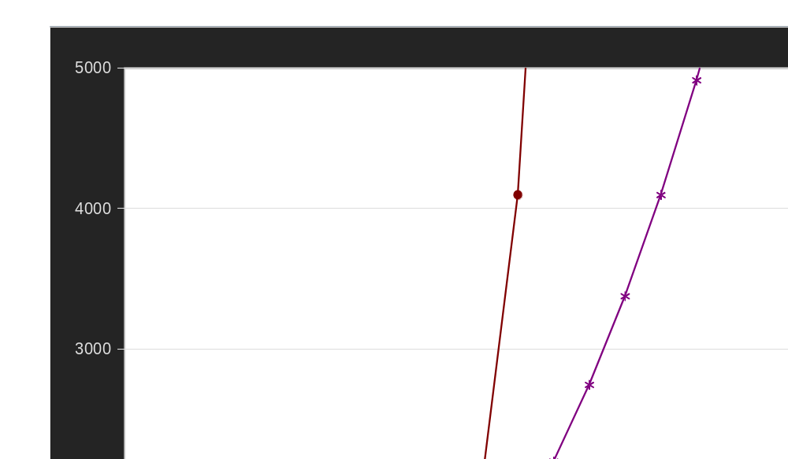
Practical Complexity
February 12, 2020
Instructor:- Mr. Fazl-e-Basit

Slide 53
Useful Properties
Transitivity
f(n) = Θ(g(n)) & g(n) = Θ(h(n)) ⇒ f(n) = Θ(h(n))
f(n) = O(g(n)) & g(n) = O(h(n)) ⇒ f(n) = O(h(n))
f(n) = Ω(g(n)) & g(n) = Ω(h(n)) ⇒ f(n) = Ω(h(n))
Reflexivity
f(n) = Θ(f(n))
f(n) = O(f(n))
f(n) = Ω(f(n))
Symmetry
f(n) = Θ(g(n)) if and only if g(n) = Θ(f(n))
February 12, 2020
Instructor:- Mr. Fazl-e-Basit

Slide 54
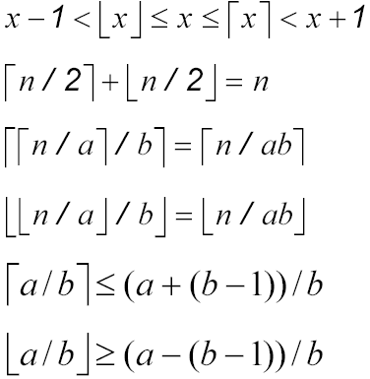


Floors and ceilings
Stands for “floor of x”
( greatest integer less than or equal to x )
Stands for “ceiling of x”
( least integer greater than or equal to x )
February 12, 2020
Instructor:- Mr. Fazl-e-Basit

